Slide 1
Basic 12 Review - Jeopardy
Vocabulary
20 points | 20 points | 20 points | 20 points | 20 points | 20 points
30 points | 30 points | 30 points | 30 points | 30 points | 30 points
40 points | 40 points | 40 points | 40 points | 40 points | 40 points
50 points | 50 points | 50 points | 50 points | 50 points | 50 points
Questions
Picture
this
Expressions
Grammar
Adjective

Slide 2

Question: Vocabulary for 20 points
What is a telephone directory?

Slide 3

Answer: Vocabulary for 20 Points
It’s book where you can find people’s or businesses phone numbers.

Slide 4
Question: Vocabulary for 30 points
What is another name for public phone?

Slide 5
Answer: Vocabulary for 30 points:
Pay phone

Slide 6
Question: Vocabulary for 40 points
What does bill mean?

Slide 7
Answer: Vocabulary for 40 Points
It is a list showing how much you have to pay for services.

Slide 8
Question: Vocabulary for 50 points
What does kennel mean?

Slide 9
Answer: Vocabulary for 50 points
It is a place where pets stay when their owners leave town

Slide 10
Question: Verb for 20 Points
What does give away mean?

Slide 11
Answer: Verb for 20 Points
a) It means to give something as a present. Something you don’t want back

Slide 12
Question: Verb for 30 points
Mention 4 activities that you do before a trip

Slide 13
Answer: Verb for 30 Points
Pay the bills, unplug any electrical items, confirm the flight plans, etc

Slide 14
Question: Verb for 40 points
Mention 5 different verb combinations you use with phones(or cellphones)

Slide 15
Answer: Verb for 40 points
Enter a phone number, leave a message, receive a phone call, etc

Slide 16
Question: Verb for 50 points
What are the past participles of these verbs:
Go, come, have, write, visit, see, take

Slide 17
Answer: Verb for 50 points
Gone, come, had, written, visited, seen, took.

Slide 18
Question: Expressions for 20 points
What are two expressions to ask about spelling?

Slide 19
Answer: Expressions for 20 points
How do you spell that?
Could you spell that please

Slide 20
Question: Expressions for 30 points
What are 4 expressions to show interest?

Slide 21
Answer: Expressions for 30 points
Oh really?
How interesting!
That sounds interesting
I know what you mean

Slide 22
Question: Expressions for 40 points
What are two expressions to use on the phone? (give the informal and the polite expression)

Slide 23
Answer: Expressions for 40 points
May I take a message?
Could you hold for a minute, please?

Slide 24
Question: Expressions for 50 points
Ask your friend for his usual school activities in high school

Slide 25
Answer: Expressions for 50 points
What did you use to do in High School?

Slide 26
Question: Adjective for 20 points
What does durable mean?

Slide 27
Answer: Adjective for 20 points
It means
-it lasts for a long time. Strong.

Slide 28
Question: Adjective for 30 points
What does interactive mean?

Slide 29
Answer: Adjective for 30 points
It means
-actively communicates

Slide 30
Question: Adjective for 40 points
What does rechargeable mean?

Slide 31
Answer: Adjective for 40 points
It means
-It can be used again.

Slide 32
Question: Adjective for 50 points
Describe the TV in the classroom using two adjectives and explain why.

Slide 33
Answer: Adjective for 50 points
The TV is ….. Because….

Slide 34
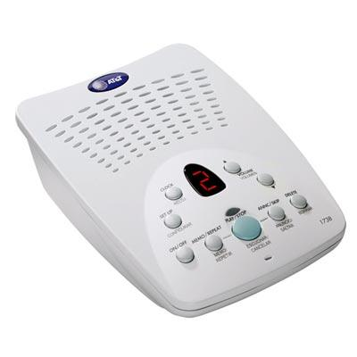
Question: Picture this for 20 points

Slide 35
Answer: Picture this for 20 points
Answering machine

Slide 36
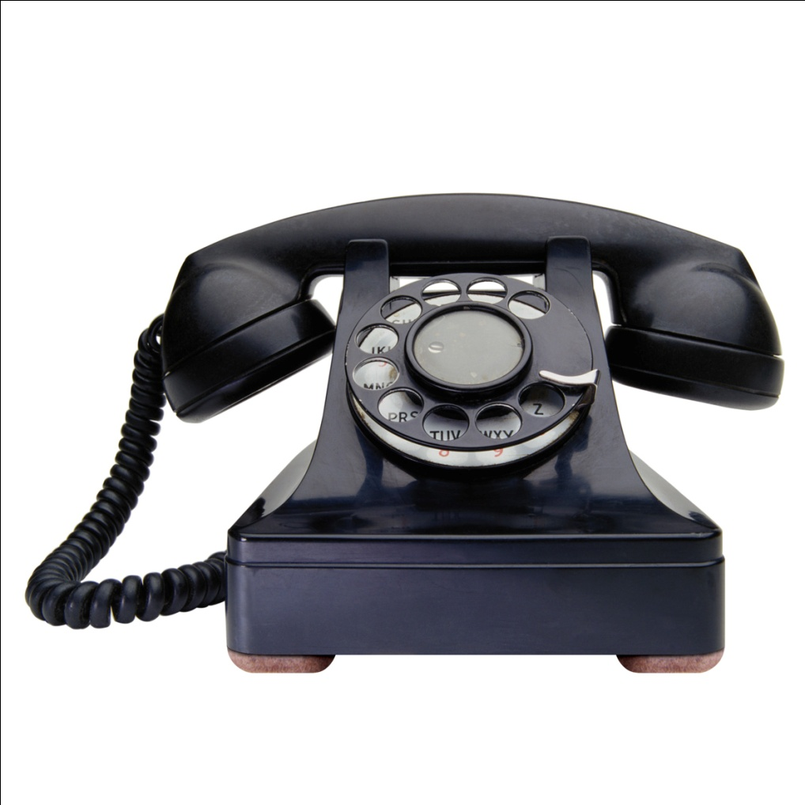
Question: Picture this for 30 points

Slide 37
Answer: Picture this for 30 points
Cord

Slide 38
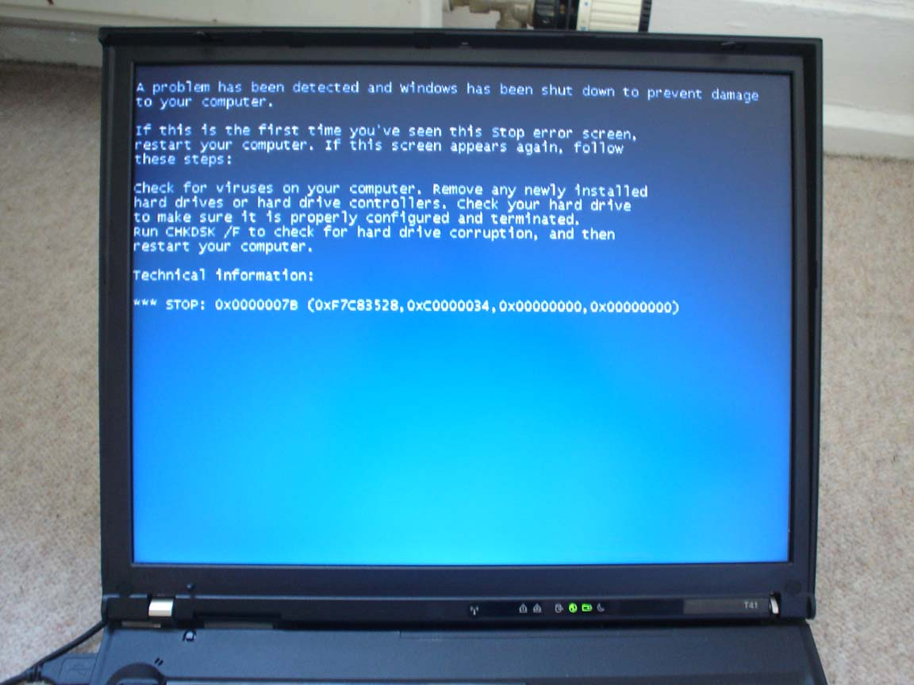
Question: Picture this for 40 points
What happened?

Slide 39
Answer: Picture this for 40 points
The computer crashed

Slide 40
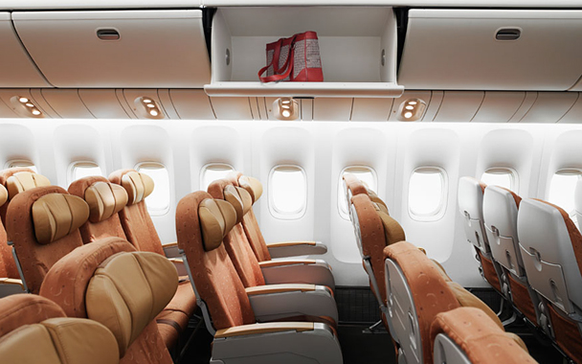
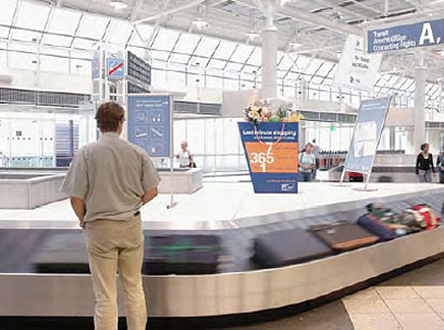
Question: Picture this for 50 points

Slide 41
Answer: Picture this for 50 points
Overhead compartment
Baggage claim

Slide 42
Question: Grammar for 20 points
I (go) ______ to Lima many times.

Slide 43
Answer: Grammar for 20 points
Have gone.

Slide 44
Question: Grammar for 30 points
Ask your friend for his past experiences flying on an airplane.

Slide 45
Answer: Grammar for 30 points
Have you flown on an airplane?

Slide 46
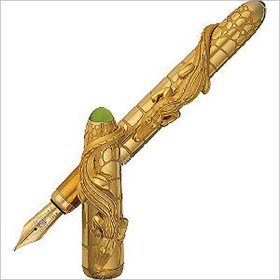
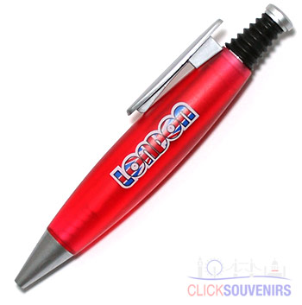
Question: Grammar for 40 points
Please compare both pens

Slide 47
Answer: Grammar for 40 points
The red pen is not as… as…

Slide 48
Question: Grammar for 50 points
What are the present and past forms or modal verbs to express necessity?

Slide 49
Answer: Grammar for 50 points
I must, I have to, I’ve got to
I had to
I don’t have to / I didn’t have to

